Slide 1

Laboratory Safety
Rules and Procedures

Slide 2
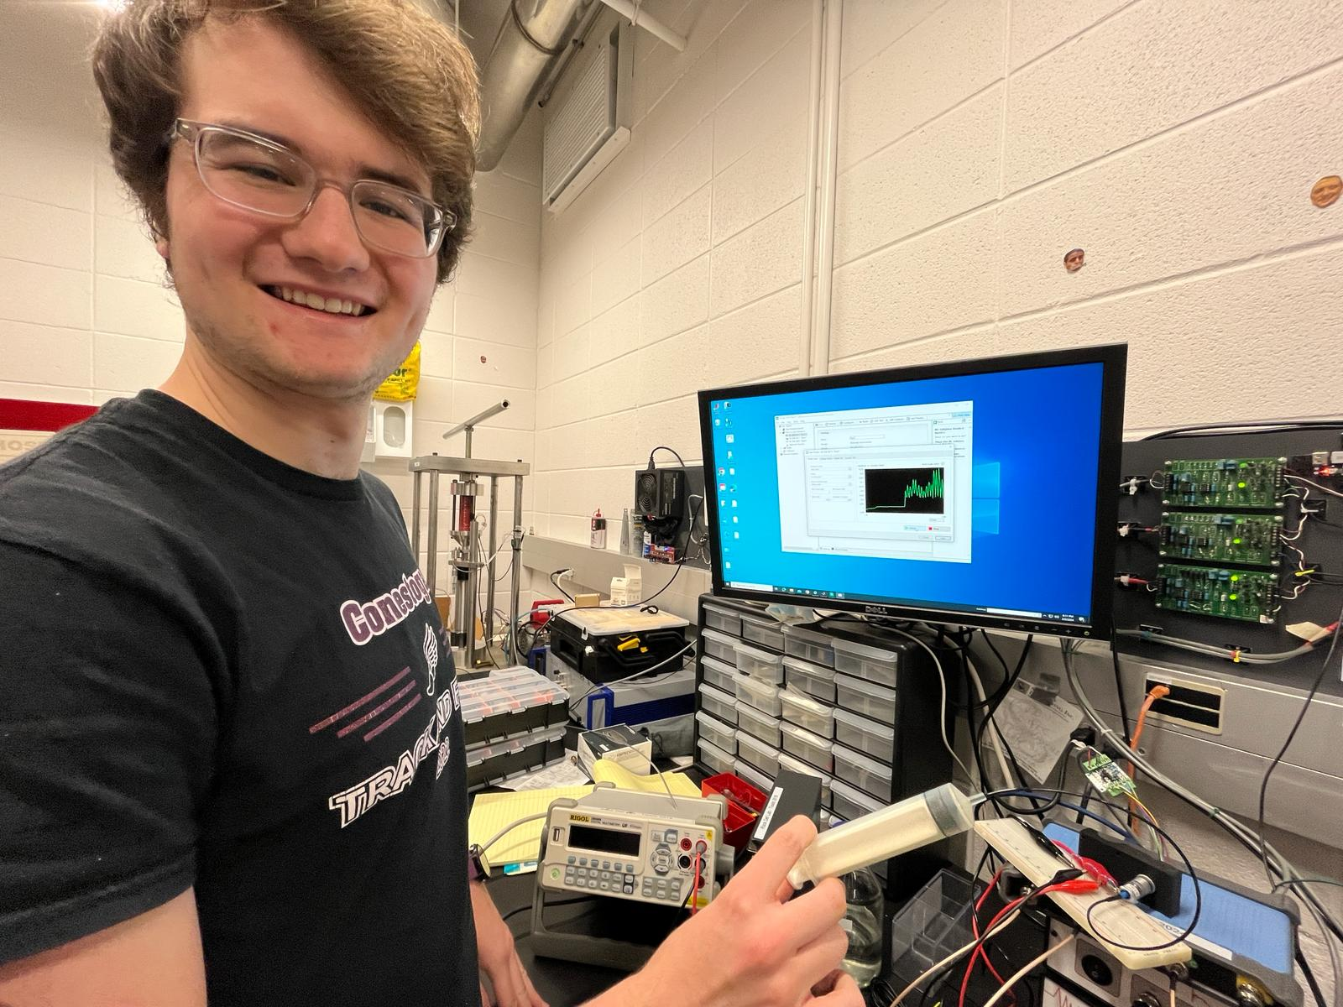
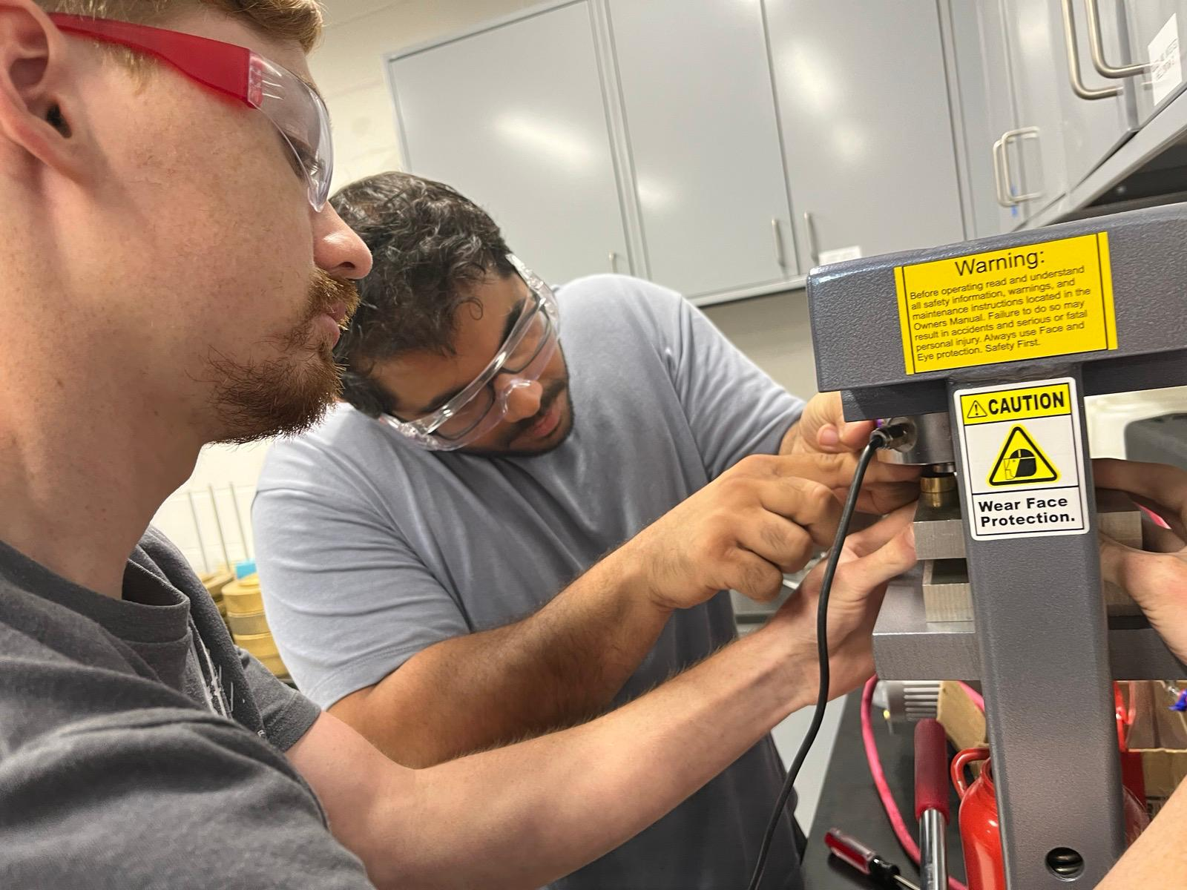

Why is lab safety important?
Protect people
Protect the lab and the environment

Slide 3
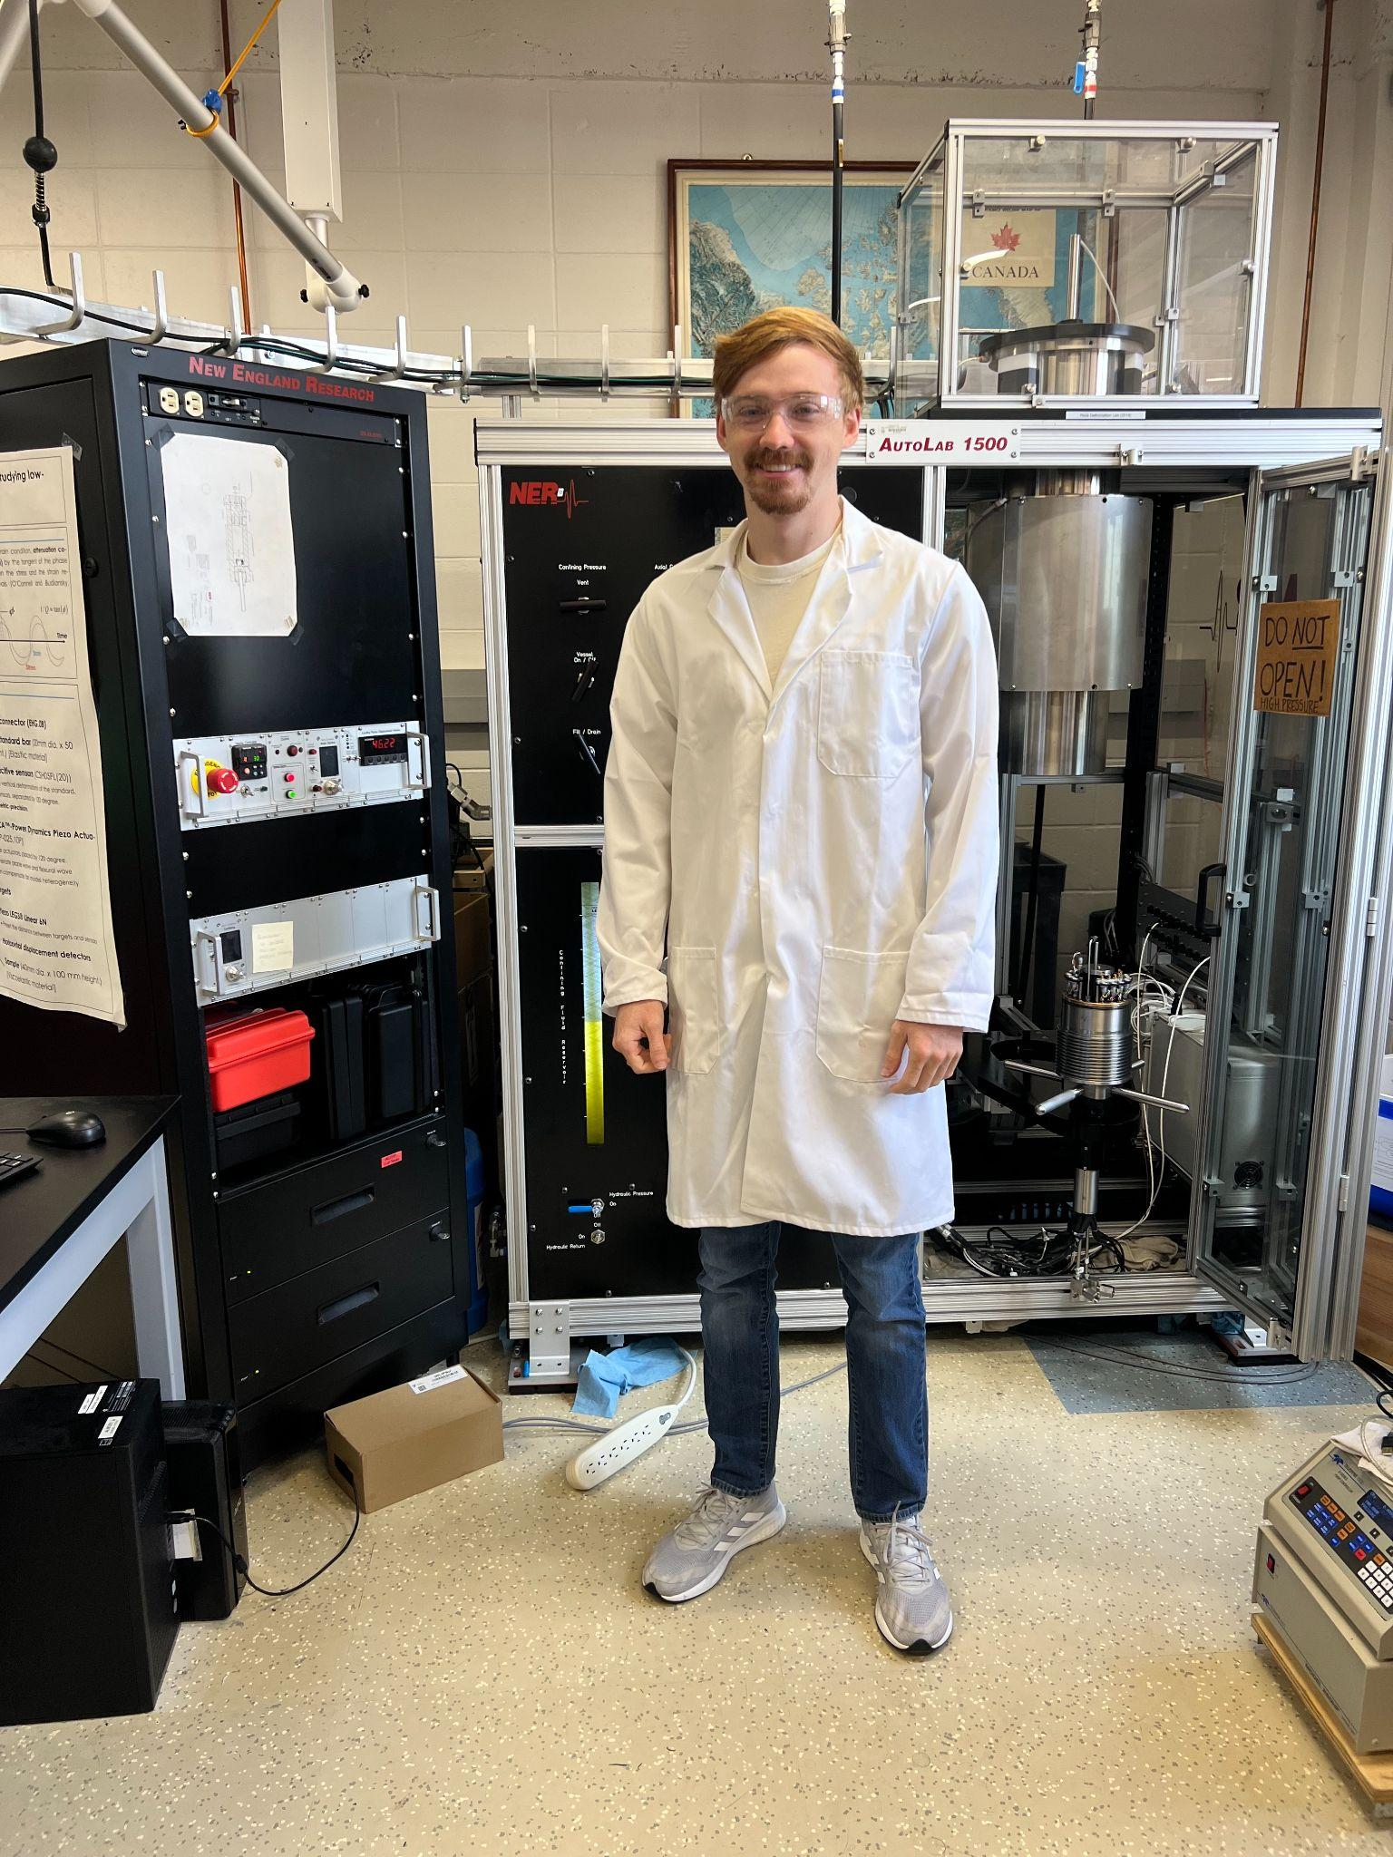
Lab Attire Policy
Full length pants and closed-toe shoes
Hair that is shoulder length or longer should be pinned or tied back
Personnel need to wear lab coats, gloves, eye protection in labs where hazardous materials are utilized

Slide 4
Behavior Expectations Housekeeping
Consult senior lab personnel
Do not defeat safety devices/features
No eating or drinking in labs
Never remove tools or equipment from labs
Minors not permitted in labs without authorization
Keep aisles and walkways clear
Keep lab benches organized and cleaned
Keep personal items out of the lab

Slide 5
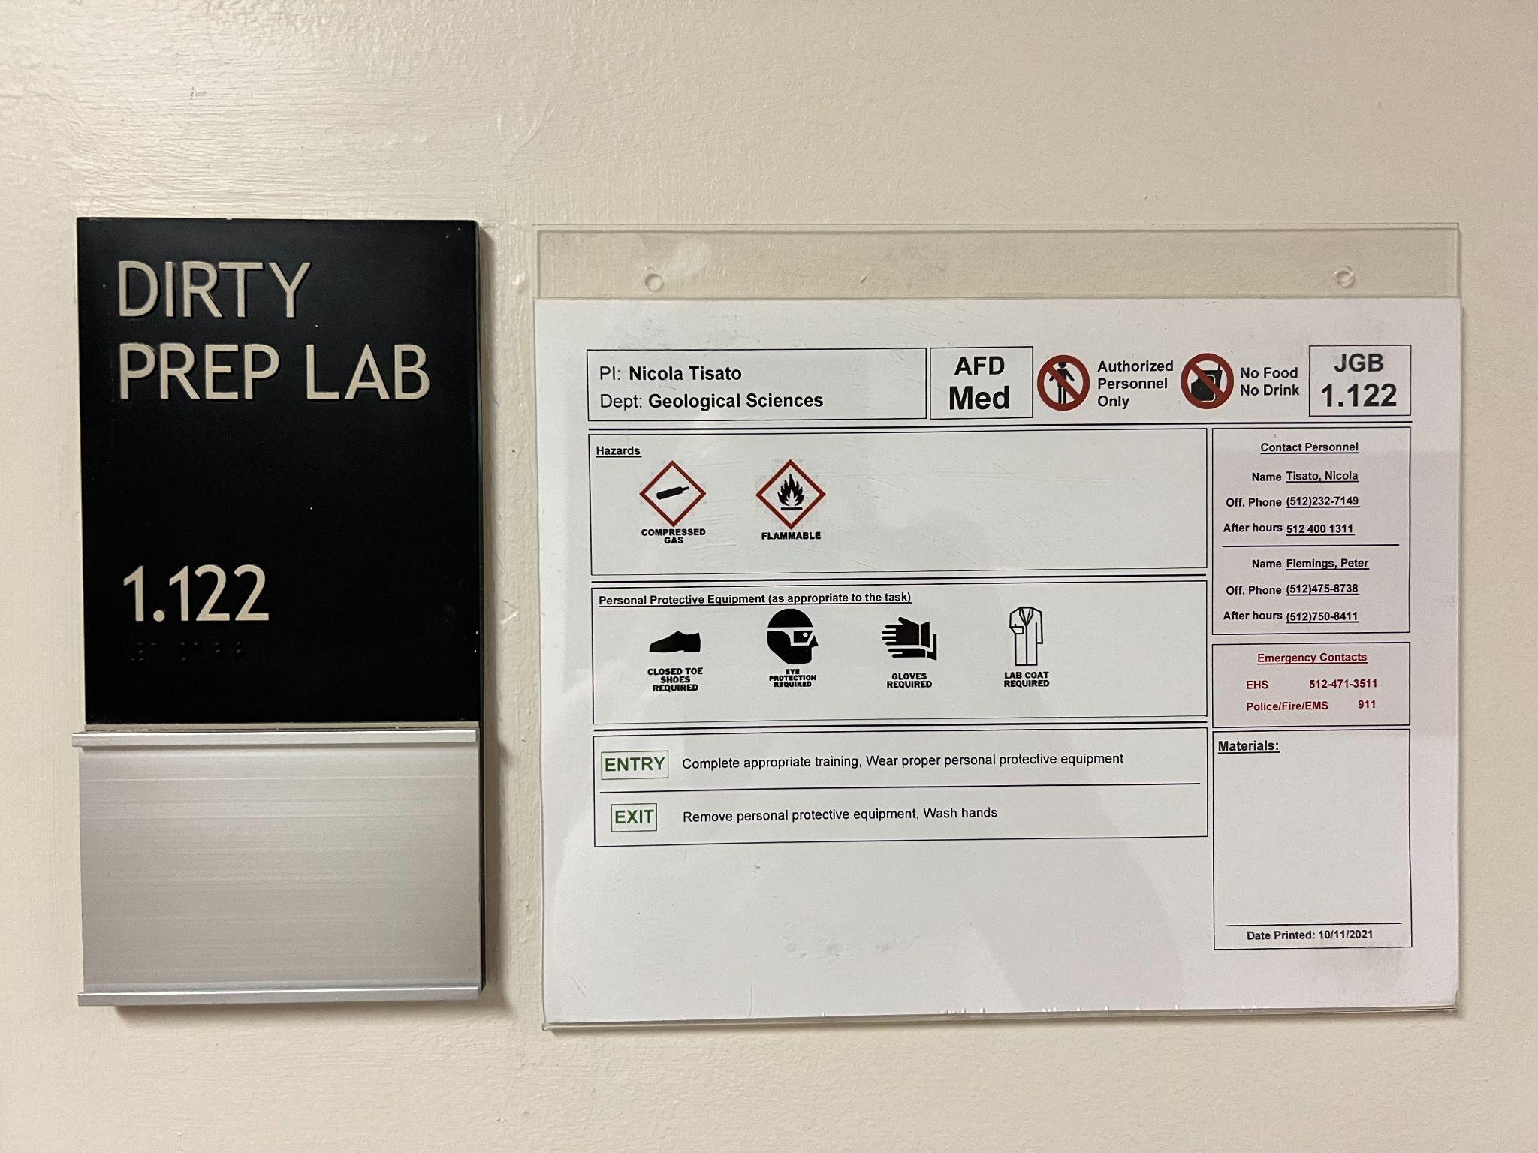
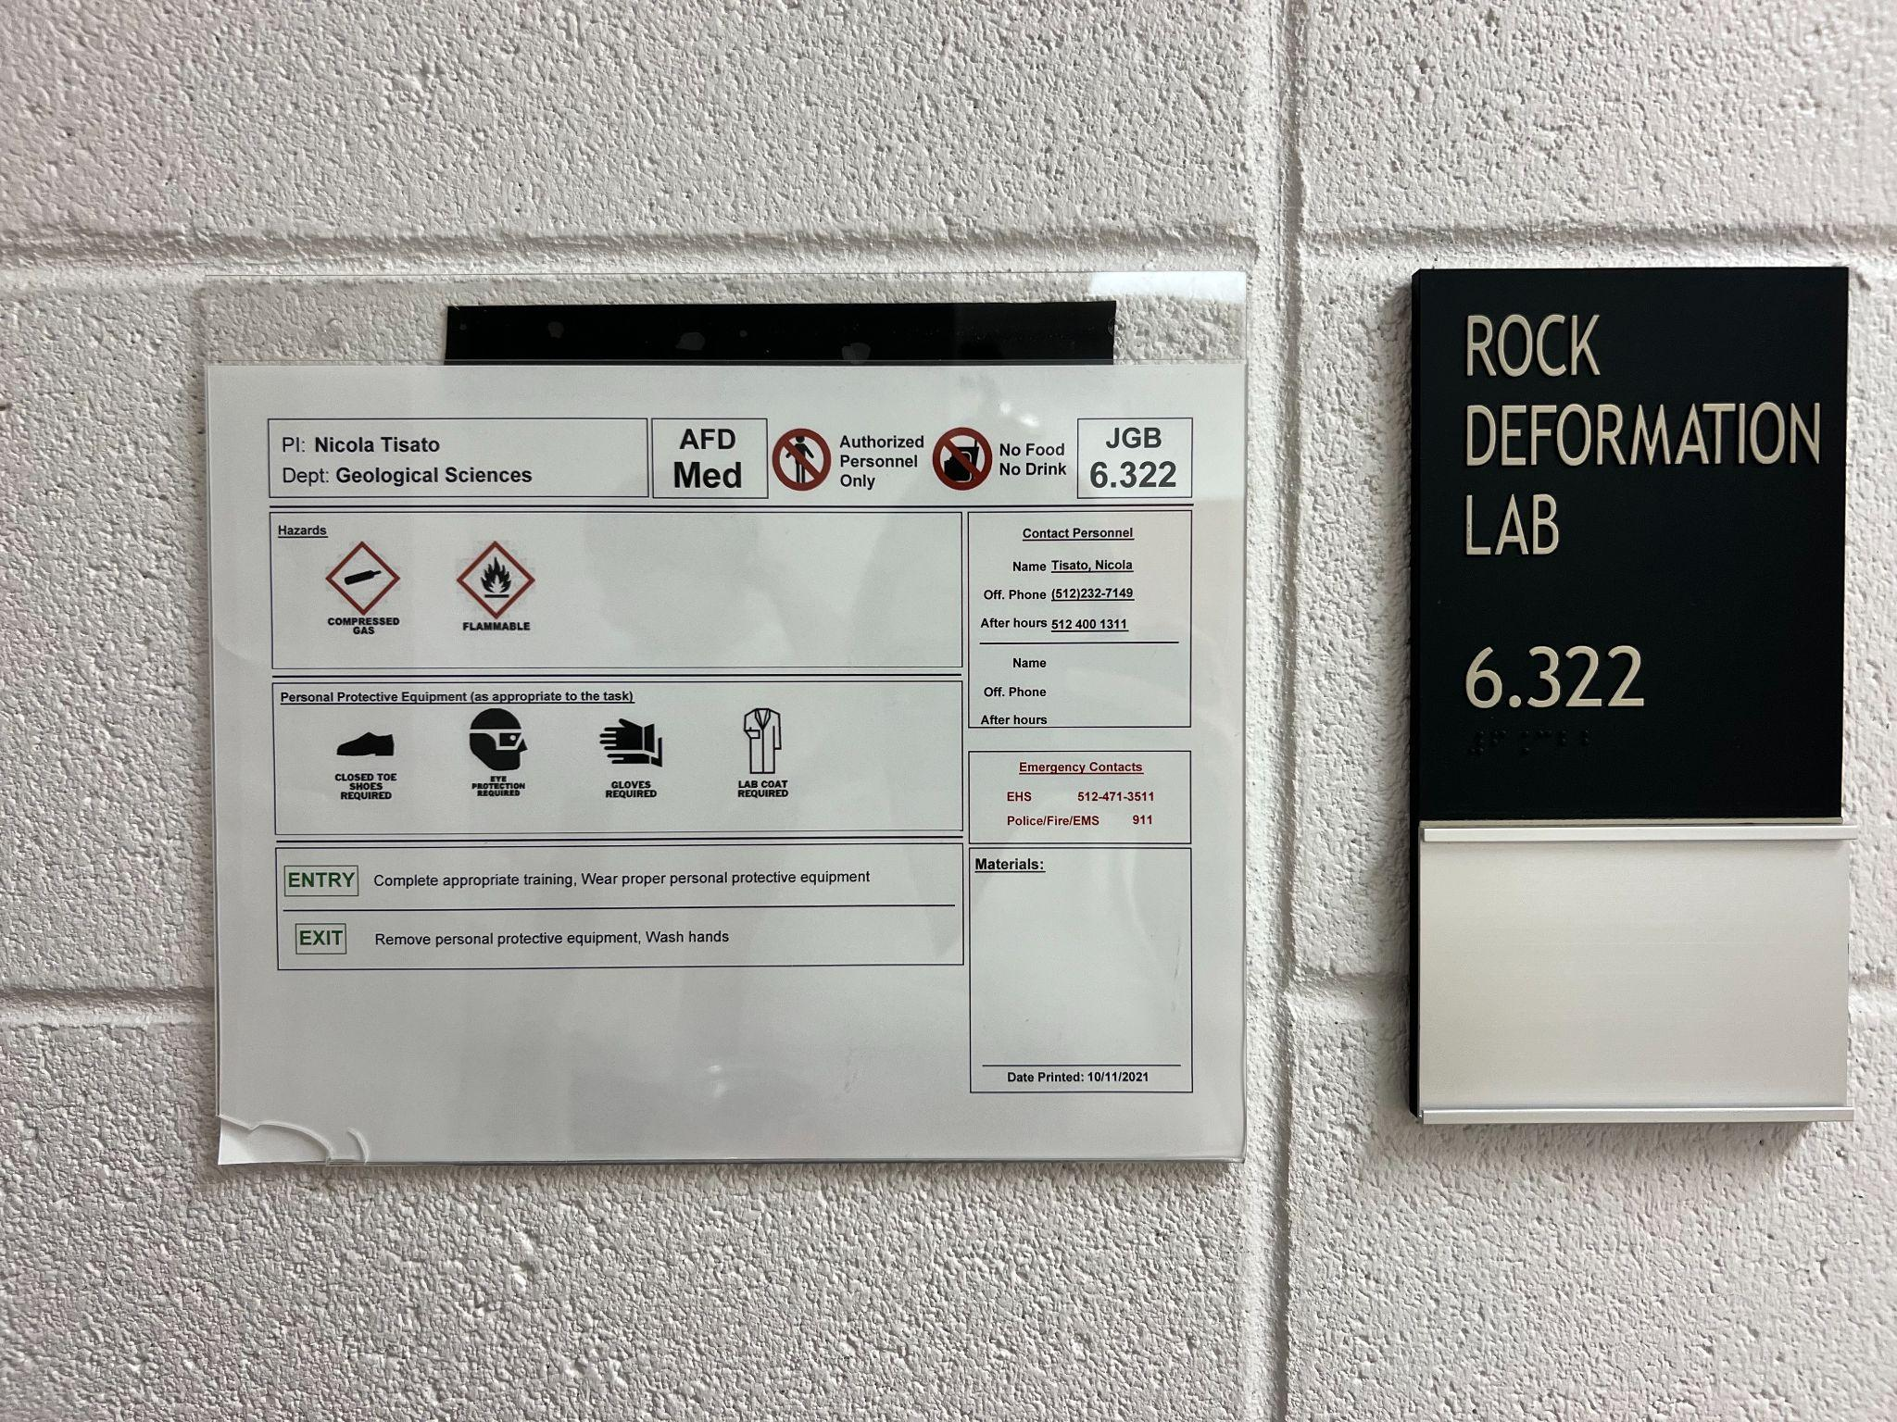
Emergency Procedures
See lab signs and emergency signs
Signs communicate hazards and emergency contacts

Slide 6


Emergency Procedures
Emergency shower
Know location
Remove clothing
Rinse minimum of 15 minutes
Emergency eyewash
Hold eyelids open
Move eyes around
Rinse minimum of 15 minutes
Fire
Evacuate the building
Dial 911

Slide 7
Lab Notebook
Record of your work and reference tool
Expect to take notes during class lectures, lab lectures, and during experiments
Include
Name & Date
Collaborators
Objective or Goal
Procedure
Notes
Reminders
Sketches
Calculations
Conversions

Slide 8
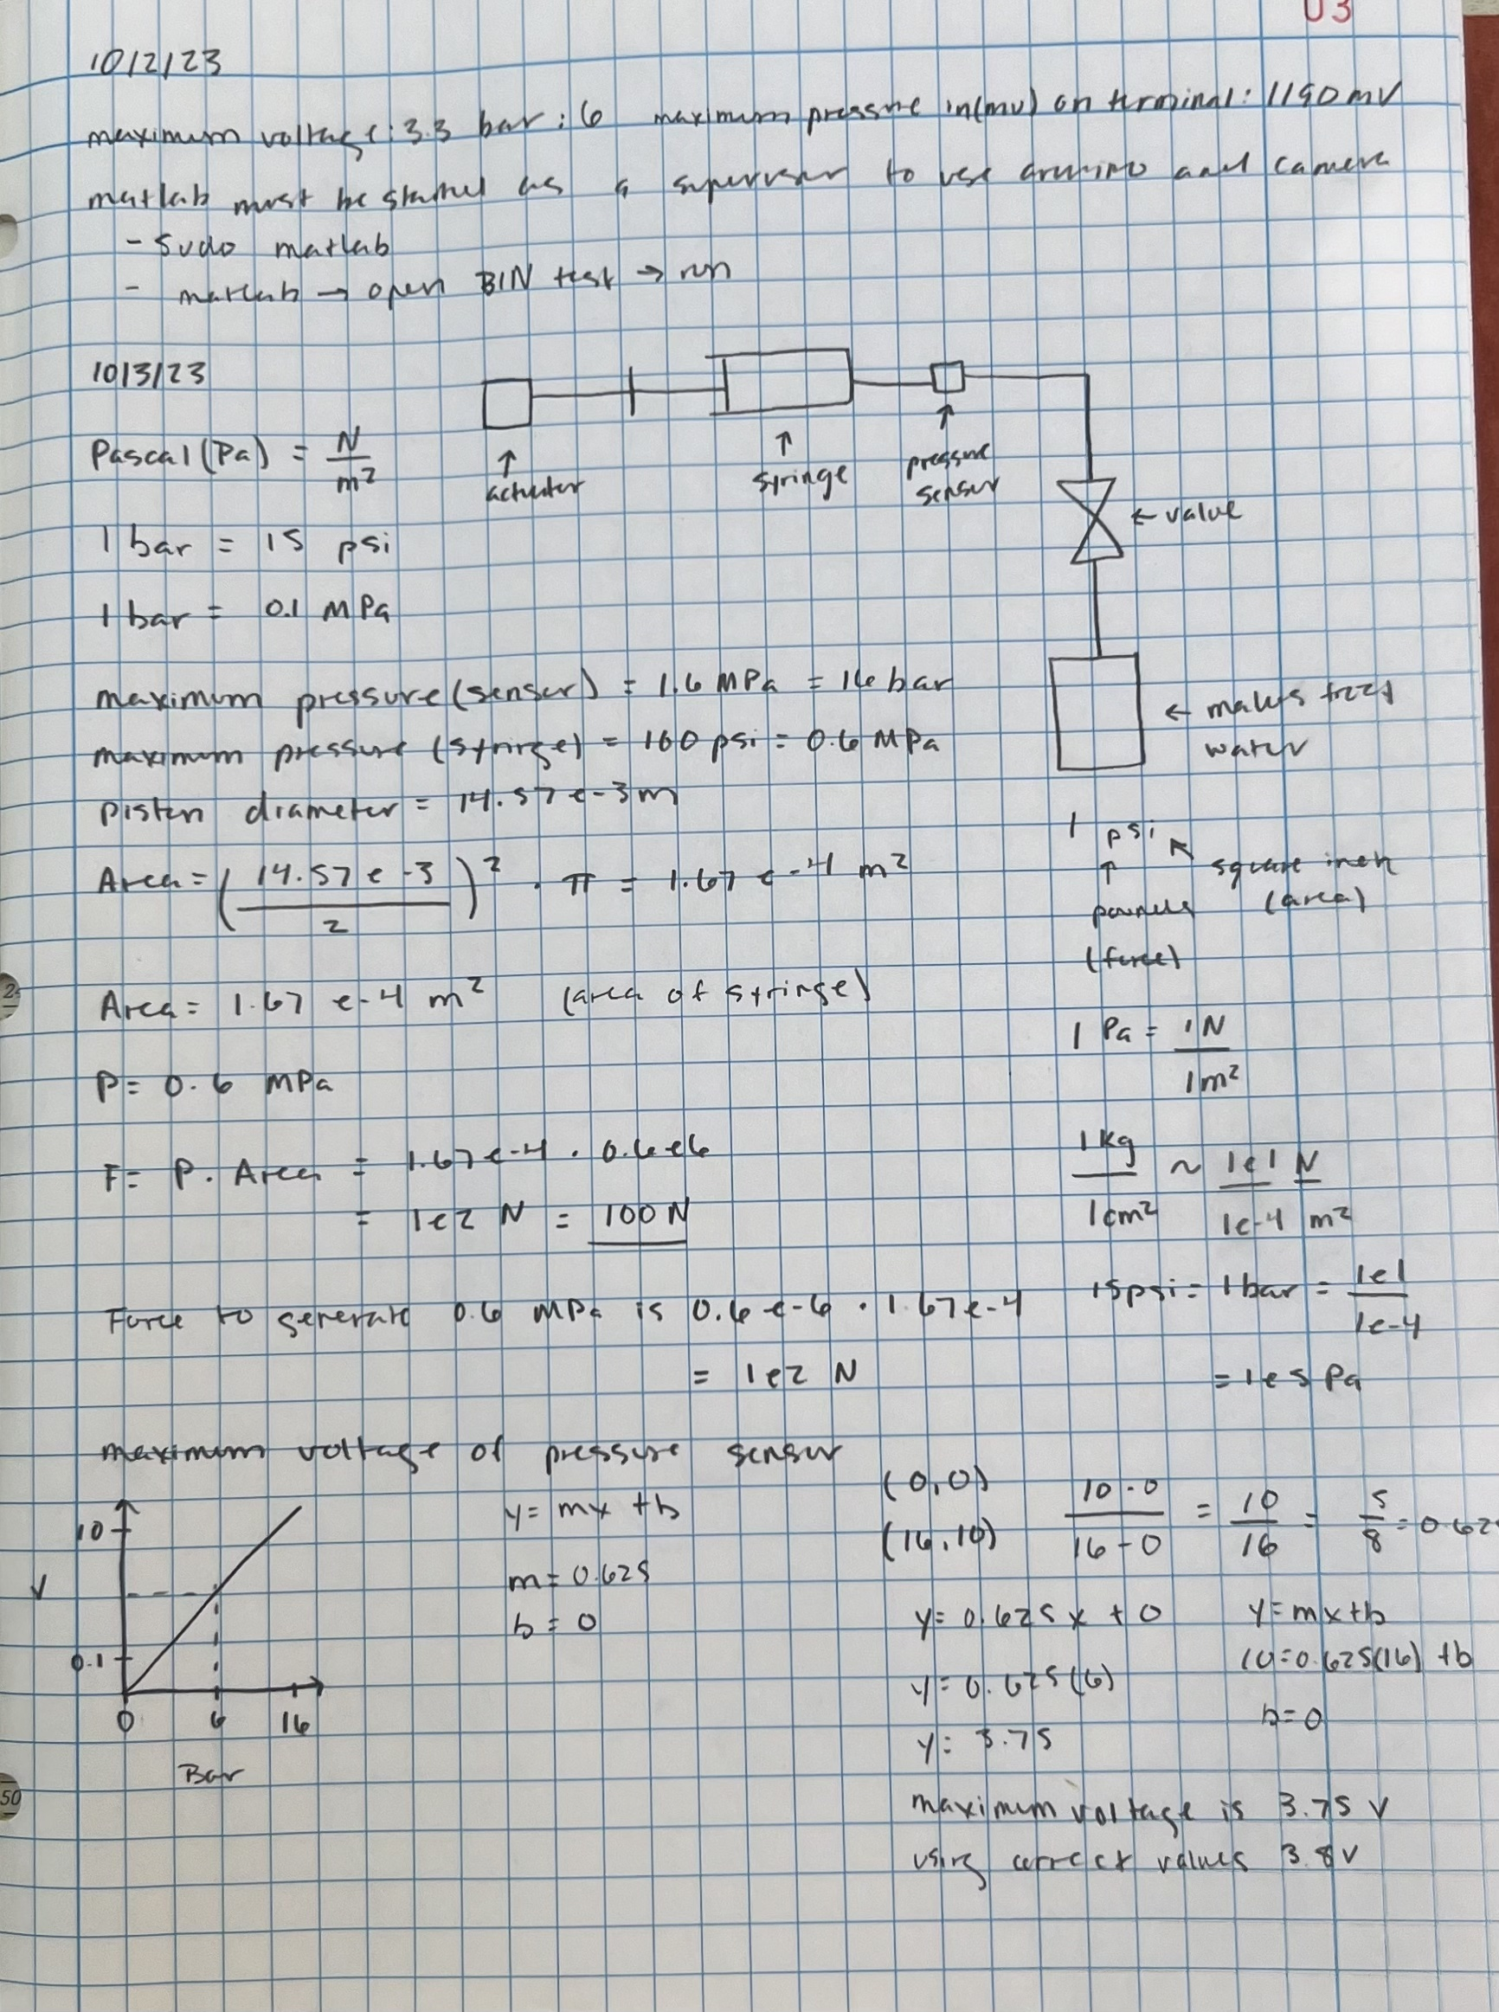
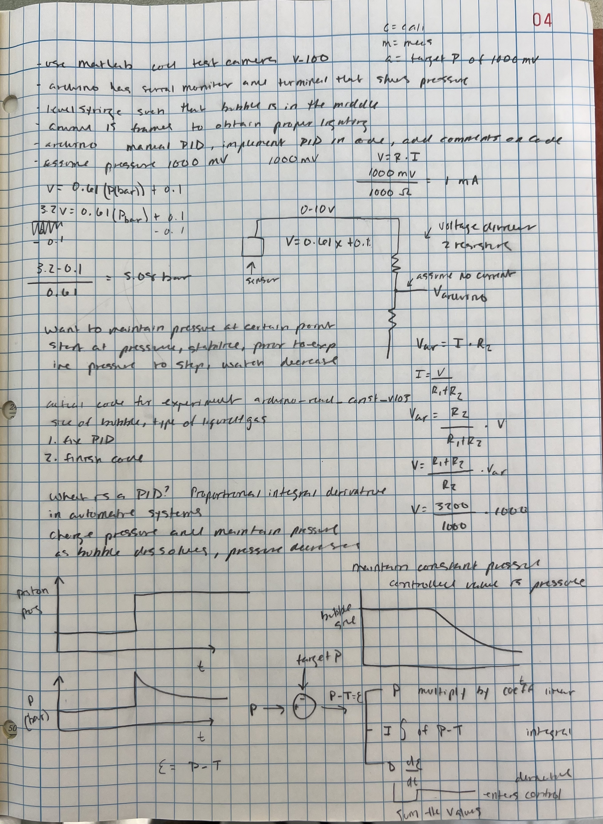
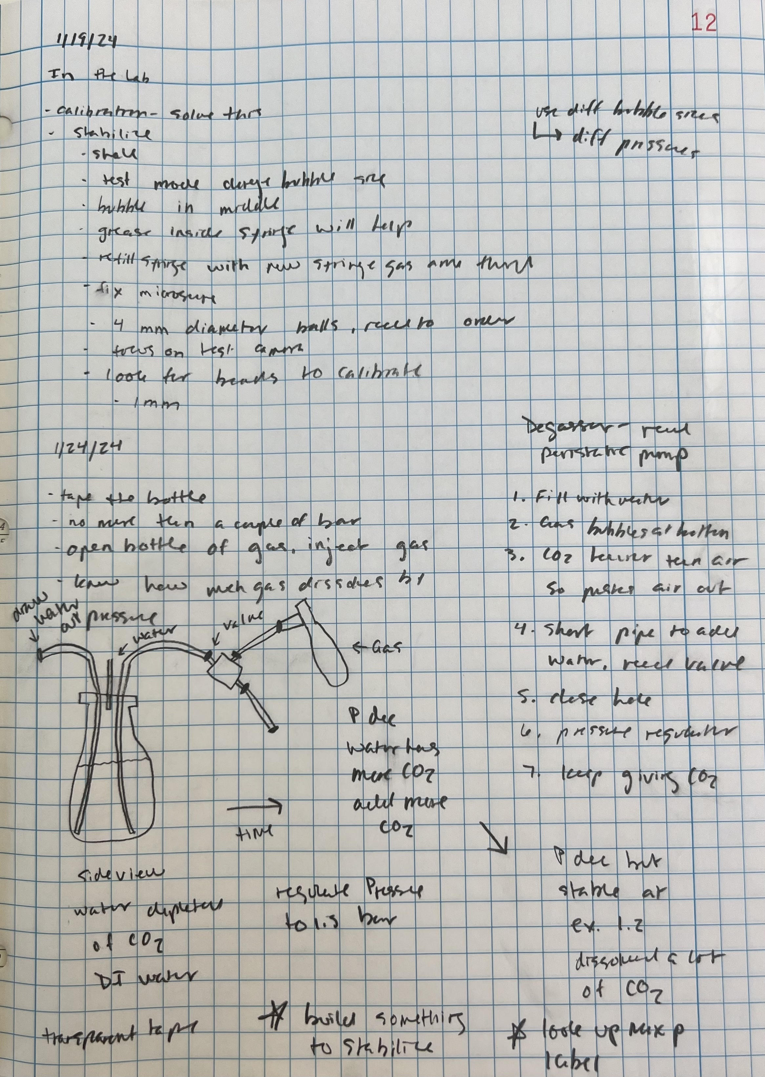
Lab Notebook Example
Isabelle’s Lab Notebook

Slide 9
THANK YOU

